Slide 1
Authentication and Authorization
Bhawna Gunwani
Corporate Trainer and Consultant

Slide 2
What is Serverless Function?

Slide 3
Authentication
Authentication is the process of verifying the identity of a user, device, or system to ensure that it is who or what it claims to be. It is a fundamental security mechanism used in digital systems to allow only legitimate users or entities to access resources.

Slide 4
Types of Authentication
Password-Based Authentication:
Uses physical characteristics like fingerprints, face, or voice.
Example: Logging into a website with an email and password.
Multi-Factor Authentication (MFA):
Requires multiple forms of verification:
Something you know (password).
Something you have (OTP or hardware token).
Something you are (biometrics).
Example: Online banking requiring a password and an OTP.

Slide 5
Types of Authentication
Biometric Authentication:
The most common form using a username and password.
Example: Logging into a website with an email and password.
Multi-Factor Authentication (MFA):
Requires multiple forms of verification:
Something you know (password).
Something you have (OTP or hardware token).
Something you are (biometrics).
Example: Online banking requiring a password and an OTP.

Slide 6
Common Use Cases
APIs
Handle RESTful or GraphQL API endpoints.
Webhooks
Respond to events from external services
Microservices
Implement isolated, small-scale services.
Background Jobs
Perform asynchronous tasks like image processing or sending emails.
Authentication
Validate tokens, handle user login, and manage sessions.
Notifications
Send notifications like emails, SMS, or push messages.

Slide 7
How Serverless Function Works?
Deployment: Code is deployed to a serverless platform (e.g., AWS Lambda, Vercel).
Trigger: The function is triggered by an event.
Execution: The platform runs the function in a managed environment.
Scaling: The platform automatically scales the function to handle incoming requests.
Stateless: Each invocation is independent, with no memory of past executions.
Response: The function returns a response (e.g., data, result, or acknowledgment).

Slide 8
Example of Serverless Function
In a Next.js app, an API route is an example of a serverless function:
// pages/api/hello.ts
export default function handler(req, res) {
res.status(200).json({ message: 'Hello, World!' });
}

Slide 9
Benefits
Cost-effective (pay-per-use)
Auto-scaling
Faster deployment
High availability
Event-driven
Focus on business logic

Slide 10
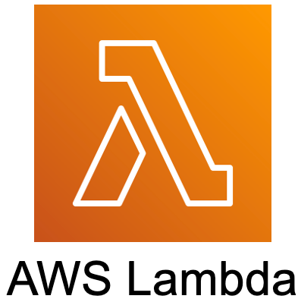



Serverless Platforms

Slide 11
What is Middleware?

Slide 12
Complex API Requests
Middleware is a piece of code that sits between the client and the server in a web application. It intercepts and processes requests and responses before they reach their final destination. Middleware functions are commonly used in web frameworks like Express (Node.js), Next.js, and others to modify or handle HTTP requests, responses, or even control the flow of the application.

Slide 13
Features
Response Processing: Modifies outgoing responses before sending them to the client.
Code Reusability: Enables reusable logic across multiple routes.
Error Handling: Centralizes error handling for consistent and clean error responses.
Granular Control: Can be applied globally, to specific routes, or conditions.
Security: Enforces authentication, authorization, and input validation.

Slide 14
Types of Middleware
Application-Level
Route-Level
Error- Handling
Built-In
Custom

Slide 15
Benefits
Code Reusability: Apply logic across multiple routes.
Error Handling: Centralizes error management for consistent responses.
Security: Enforces authentication, authorization, and input validation.
Modularity: Easily add or modify functionality without changing core logic.
Customizable: Tailor middleware for specific needs.

Slide 16
Example
const express = require('express');
const app = express();
// Custom Middleware to log request details
app.use((req, res, next) => {
console.log(`Request URL: ${req.url}`);
console.log(`Request Method: ${req.method}`);
next(); // Pass the request to the next middleware
});
// Route handler
app.get('/home', (req, res) => {
res.send('Hello, Home!');
});
// Start the server
app.listen(3000, () => {
console.log('Server is running on port 3000');
});

Slide 17




Slide 18

Coffee Break

Slide 19

Check your Knowledge

